Slide 1
Finding best locality for renting in Bangalore, India
By Udit Bhargava

Slide 2
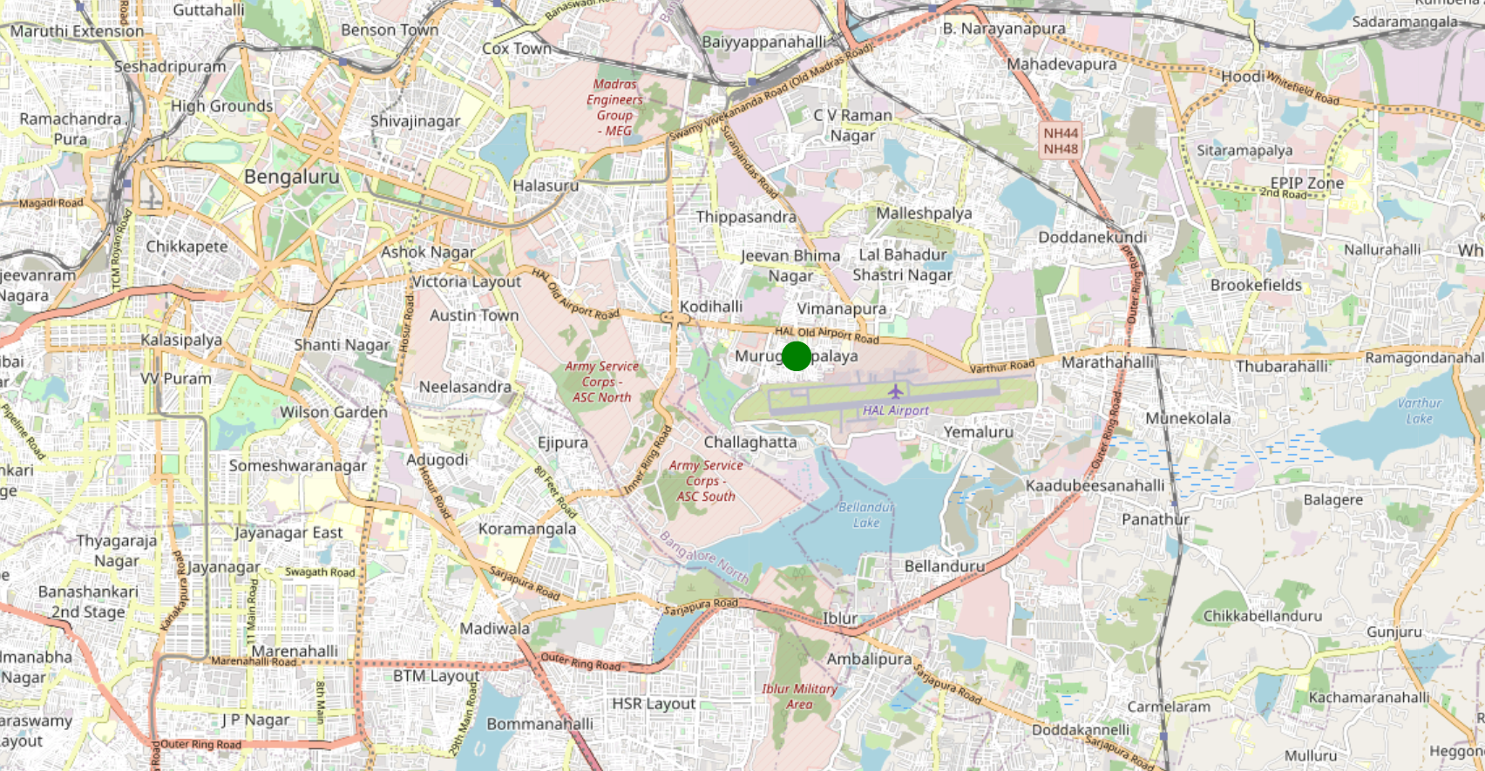
Problem Statement
The aim of the project is to find the most suitable renting locality in the city of Bangalore based on the following criteria
Proximity to Office
Nearby Facilities
Affordability
Office Location

Slide 3
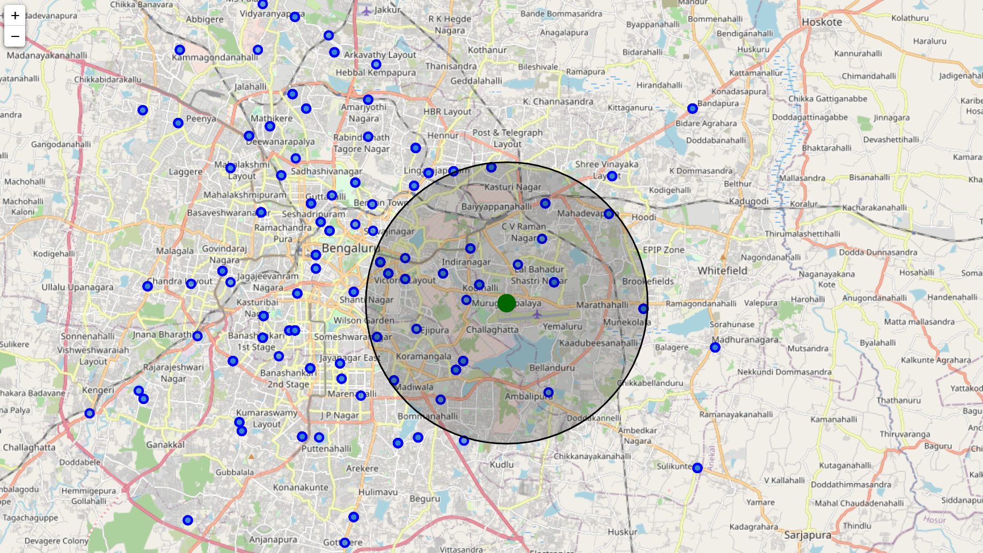
Proximity to Office
Using a combination of publically available data and geocode library find out all the localities in Bangalore and calculate the distance from office

Slide 4
Nearby Facilities
Take input from user about his most preferred venue categories to be considered while finalising the locality
Based on the output of foursquare API, rate all localities based on the venues nearby and user preference
Locality | Rating | Locality | Rating | Locality | Rating | Locality | Rating
Adugodi | 1 | Cubban Road | 4 | Jalavayuvihar | 0 | Narayan Pillai street | 4
Agara | 2 | Dharmaram College | 1 | Jeevanbhimanagar | 2 | New Thippasandra | 1
Agram | 1 | Domlur | 3 | K H b colony | 0 | Rajbhavan | 4
Air Force hospital | 1 | Doorvaninagar | 0 | Kalyanagar | 0 | Ramagondanahalli | 2
Austin Town | 0 | Dr. ambedkar veedhi | 4 | Kamakshipalya | 0 | Ramamurthy Nagar | 0
Banaswadi | 0 | H.A.l ii stage | 4 | Kendriya Sadan | 2 | Richmond Town | 8
Bangalore Air port | 1 | Highcourt | 4 | Koramangala | 2 | Sivan Chetty gardens | 1
Bangalore Bazaar | 4 | Hoodi | 2 | Koramangala I block | 2 | Someswarapura | 4
Bangalore Sub fgn post | 8 | Horamavu | 0 | Koramangala Vi bk | 3 | St. john's medical college | 2
Bangalore. | 4 | Hosur Road | 1 | Krishnarajapuram R s | 0 | Taverekere | 1
Basaveshwaranagar | 0 | Hsr Layout | 3 | Legislators Home | 4 | Vidhana Soudha | 4
Bellandur | 0 | Hulsur Bazaar | 4 | Mahadevapura | 2 | Vimapura | 1
Brigade Road | 4 | Immedihalli | 2 | Mahatma Gandhi road | 4 | Viveknagar | 0
C.V.raman nagar | 1 | Indiranagar | 9 | Museum Road | 8 | Whitefield | 2
Cmp Centre and school | 8 | Indiranagar Com. complex | 9 | Nal | 1

Slide 5
Affordability
Using external data providers to find our average 2-BHK INR rent for different localities in Bangalore. External link used
https://www.makaan.com/price-trends/property-rates-for-rent-in-bangalore
Merge the distance, rating and rent information, in a single table and sanitize the data
Locality | Distance (km) | Rating | Rent | Locality | Distance (km) | Rating | Rent
Indiranagar | 3.009491 | 9 | 38333.33 | K H b colony | 3.341203 | 0 | 16000
Domlur | 1.854605 | 3 | 44571.43 | Austin Town | 4.826111 | 0 | 30000
H.A.l ii stage | 1.516027 | 4 | 18000 | Bellandur | 4.552968 | 0 | 19200
Vimapura | 0.078934 | 1 | 12750 | Viveknagar | 4.826111 | 0 | 21500
Richmond Town | 5.626635 | 8 | 31000 | Adugodi | 6.187522 | 1 | 35450
New Thippasandra | 1.83279 | 1 | 21500 | Hosur Road | 6.187522 | 1 | 33000
Koramangala Vi bk | 4.342902 | 3 | 39000 | Jeevanbhimanagar | 6.31654 | 2 | 21400
Koramangala | 3.890116 | 2 | 29525.64 | Ramagondanahalli | 6.31654 | 2 | 21000
Mahatma Gandhi road | 6.145695 | 4 | 50400 | Krishnarajapuram R s | 4.923017 | 0 | 15176.47
Marathahalli Colony | 2.397479 | 0 | 20611.11 | Ramamurthy Nagar | 4.923017 | 0 | 14611.11
C.V.raman nagar | 3.400978 | 1 | 27500 | Doorvaninagar | 4.923017 | 0 | 14500
Kundalahalli | 2.397479 | 0 | 18000 | Mahadevapura | 6.271897 | 2 | 17521.43
Basaveshwaranagar | 3.341203 | 0 | 25000 | Whitefield | 6.31654 | 2 | 18346.65
Brigade Road | 6.145695 | 4 | 36000 | Hoodi | 6.271897 | 2 | 16500
Sivan Chetty gardens | 5.111843 | 1 | 43000 | Immedihalli | 6.31654 | 2 | 12600
Doddanekkundi | 2.397479 | 0 | 2597.67 | Kalyanagar | 6.305318 | 0 | 25160.71
Yemalur | 2.397479 | 0 | 1541.67 | Banaswadi | 6.305318 | 0 | 22178.95
Hsr Layout | 5.413138 | 3 | 26700 | Horamavu | 6.305318 | 0 | 16884.21

Slide 6
Final Metric
Based on the user defined metric, come up with a formula to calculate the final rating, the formula used here is as follows
Final Rating = -(Proximity Weight)*(Normalised Distance) + (Facilities Weight)*(Normalised Rating) + (Affordability Weight)*(Normalised Rent)
Locality | Distance (km) | Rating | Rent | Final Rating | Locality | Distance (km) | Rating | Rent | Final Rating
Indiranagar | 3.009491 | 9 | 38333.33 | 4.223302 | K H b colony | 3.341203 | 0 | 16000 | 1.307619
Domlur | 1.854605 | 3 | 44571.43 | 3.404427 | Austin Town | 4.826111 | 0 | 30000 | 0.978538
H.A.l ii stage | 1.516027 | 4 | 18000 | 3.165068 | Bellandur | 4.552968 | 0 | 19200 | 0.841303
Vimapura | 0.078934 | 1 | 12750 | 2.939794 | Viveknagar | 4.826111 | 0 | 21500 | 0.774151
Richmond Town | 5.626635 | 8 | 31000 | 2.62587 | Adugodi | 6.187522 | 1 | 35450 | 0.747007
New Thippasandra | 1.83279 | 1 | 21500 | 2.363898 | Hosur Road | 6.187522 | 1 | 33000 | 0.688095
Koramangala Vi bk | 4.342902 | 3 | 39000 | 2.154898 | Jeevanbhimanagar | 6.31654 | 2 | 21400 | 0.599098
Koramangala | 3.890116 | 2 | 29525.64 | 1.882305 | Ramagondanahalli | 6.31654 | 2 | 21000 | 0.58948
Mahatma Gandhi road | 6.145695 | 4 | 50400 | 1.868557 | Krishnarajapuram R s | 4.923017 | 0 | 15176.47 | 0.578653
Marathahalli Colony | 2.397479 | 0 | 20611.11 | 1.841589 | Ramamurthy Nagar | 4.923017 | 0 | 14611.11 | 0.565059
C.V.raman nagar | 3.400978 | 1 | 27500 | 1.805116 | Doorvaninagar | 4.923017 | 0 | 14500 | 0.562387
Kundalahalli | 2.397479 | 0 | 18000 | 1.778803 | Mahadevapura | 6.271897 | 2 | 17521.43 | 0.525851
Basaveshwaranagar | 3.341203 | 0 | 25000 | 1.524029 | Whitefield | 6.31654 | 2 | 18346.65 | 0.525679
Brigade Road | 6.145695 | 4 | 36000 | 1.522301 | Hoodi | 6.271897 | 2 | 16500 | 0.50129
Sivan Chetty gardens | 5.111843 | 1 | 43000 | 1.410802 | Immedihalli | 6.31654 | 2 | 12600 | 0.387498
Doddanekkundi | 2.397479 | 0 | 2597.67 | 1.408446 | Kalyanagar | 6.305318 | 0 | 25160.71 | 0.199013
Yemalur | 2.397479 | 0 | 1541.67 | 1.383054 | Banaswadi | 6.305318 | 0 | 22178.95 | 0.127315
Hsr Layout | 5.413138 | 3 | 26700 | 1.379328 | Horamavu | 6.305318 | 0 | 16884.21 | 0

Slide 7
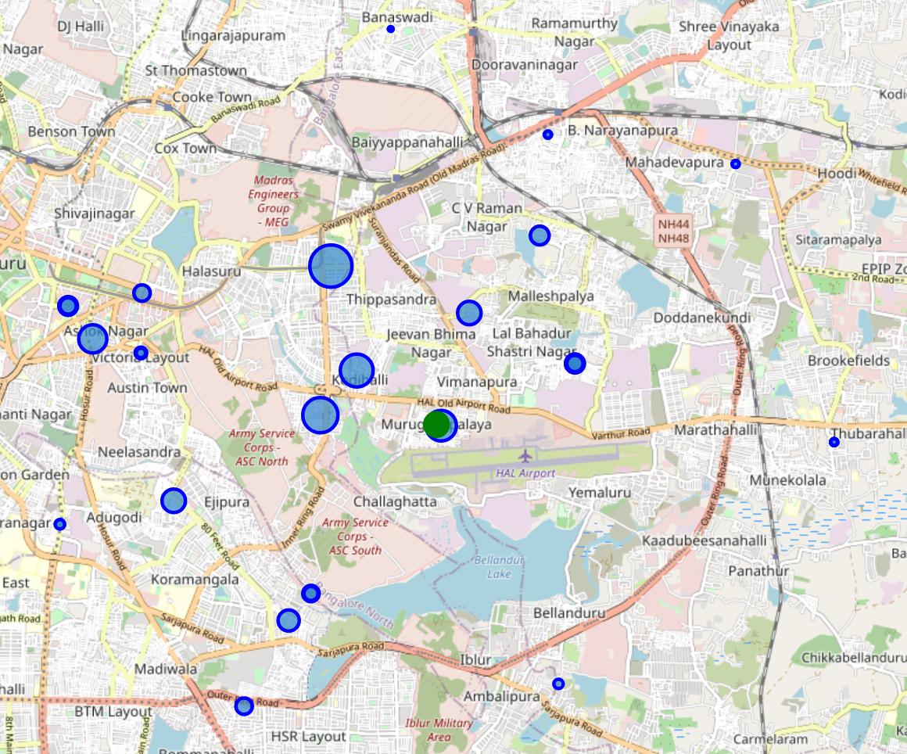
Result
Based on the final rating, below are the localities which should be preferred, the size of the marker represents the magnitude of rating
Locality | Final Rating
Indiranagar | 4.223302
Domlur | 3.404427
H.A.l ii stage | 3.165068
Vimapura | 2.939794
Richmond Town | 2.62587
New Thippasandra | 2.363898
Koramangala Vi bk | 2.154898
Koramangala | 1.882305

Slide 8
Observations, Conclusions and Future Directions
Observations
Following problems were faced while implementing this project
Some localities did not have rent data as the data source for gathering the pin code vs locality data was different from source of getting rent data
Some datapoints which had spelling difference or extra space were manually corrected to match with that of pin code data
Conclusions
Based on our analysis, the user can now communicate his preferences to the broker beforehand and do a more focused and well rounded search for a suitable locality
Also the analysis made sure user preferences and interests are taken into account so that he might not get a surprise in the future and that the user has been made available all the imp info so that he can make a well informed decision
Future Directions
More number of criterias can be added to arrive at the final outcome
Safety
Residential Areas
Historic Reviews
The problem statement can be made complex if there user has a spouse and they would need to add an additional variable of spouse’s office location and find a suitable locality midway
Formula of calculating Final Ranking can be improved based on actual survey data of multiple stakeholders and their weight to generalise

